Slide 1
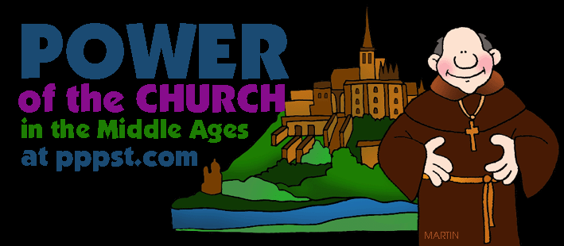
Outcome: The power of the Church
The Middle Ages

Slide 2
Constructive Response Questions
What was the role of The Church during the Middle Ages?

Slide 3
The Power of the Church
Christianity in the early Middle Ages
As society withered after the fall of Rome, Christianity was a constant
Popes and church leaders would be able to use the power vacuum in Europe as a way to expand the power of Christianity throughout the Middle Ages
Christianity was spread by:
Missionaries who risked their lives to spread Christianity
Clovis when he united the Franks through the use of Christianity
Attacks by Muslims spurred people to convert to Christianity

Slide 4
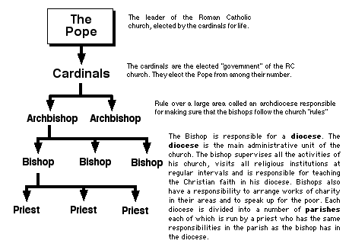
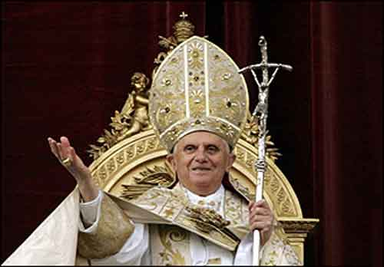
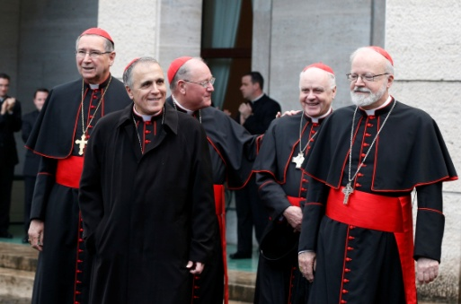
The Power of the Church
Structure of the Church
The Church had different ranks of clergy, or religious officials
Pope was head of Church
All clergy, including bishops and priests fell under pope’s authority
For most people, local priests served as the main contact with the Church

Slide 5
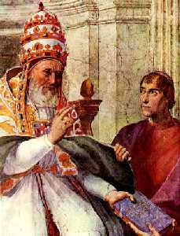
The Power of the Church
Religion as a Unifying Force
Feudalism created division but Church teachings bonded them together
Provided people with a sense of security and of belonging to a religious community
Priests and other clergy administered sacraments (religious ceremonies)
All were subject to canon law, or Church Law

Slide 6
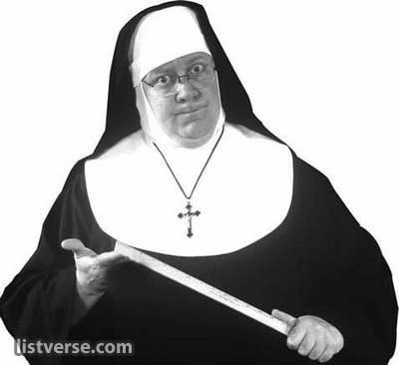
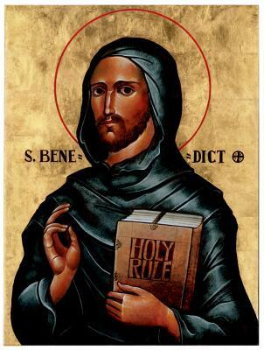
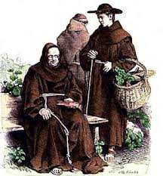
The Power of the Church
Education
The Church offered the only place to receive an education in the Middle Ages
Monasteries were religious communities for men
Men in monasteries were called monks and gave up possessions to devote a life serving God
Women, or nuns, lived in convents
St. Benedict wrote a book setting a practical set of rules for monasteries

Slide 7
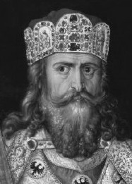
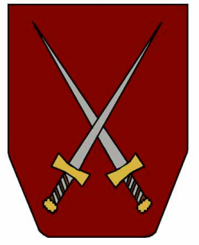
The Power of the Church
Far-Reaching Authority of the Church
The Christian Church was becoming secular or worldly; extending its influence into all aspects of daily life especially politics
Example of Secular: Pope Gregory I used church revenues to raise armies, repair roads, and help the poor
The Church sought to influence spiritual and political matters when it crowned Charlemagne Roman Emperor in 800
Pope Gelasius I suggested that God had created two swords:
One sword was religious ----> held by pope
One sword was political ----> held by the emperor
Pope bows to emperor in political matters
Emperor bows to pope in spiritual matters
If each kept authority in own realm, the two could live in harmony
Unfortunately, this separation of church and state didn’t always happen

Slide 8
The Power of the Church
The Emperor Clashes with the Pope
Church unhappy with use of lay investiture
Lay investiture: Kings appointing church officials
Pope Gregory VII banned lay investiture in 1075
German Emperor Henry IV was furious with Pope Gregory VII
Henry demanded the pope step down; Gregory excommunicated Henry
Excommunication: taking away a person’s right of membership in the Church
Henry approached Gregory for forgiveness and was forced to wait in the snow for 3 days
Power of the Pope was much greater than German kings
Future kings would attempt to exert power over the papacy (pope)
These attempts would weaken German provinces in Europe

Slide 9
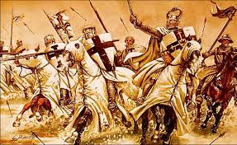
Result:
Throughout the Middle Ages, the power of the Church grew. It was able to provide unity, education, and strong empires even allowed popes to abandon morality and call for the bloody event known as The Crusades.

Slide 10
Constructive Response Questions
What was the role of The Church during the Middle Ages?

