Slide 1
Jesus & The Rise of Christianity
Reading Guide Freebies!

Slide 2
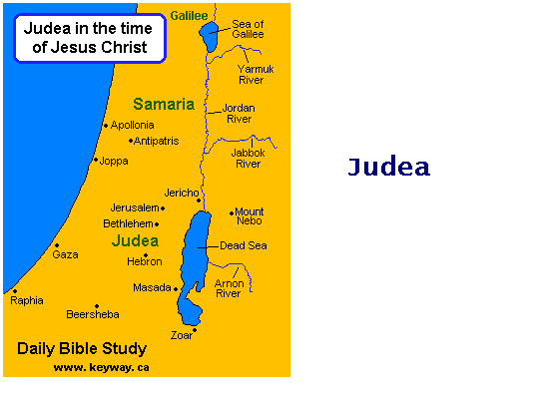
Jesus & The Rise of Christianity
What was Judea? What happened to it in 6 A.D.?
The home of the Jews.
Rome took over in 6 A.D. and made Judea a Roman Province.

Slide 3
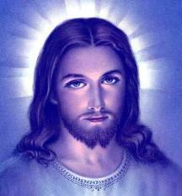
Jesus of Nazareth
When was Jesus probably born?
6-4 B.C.
At what age did he start his ministry?
Age 30

Slide 4
Jesus of Nazareth
What did Jesus do for the next 3 years?
Preached
Taught
Did good works
Performed miracles

Slide 5
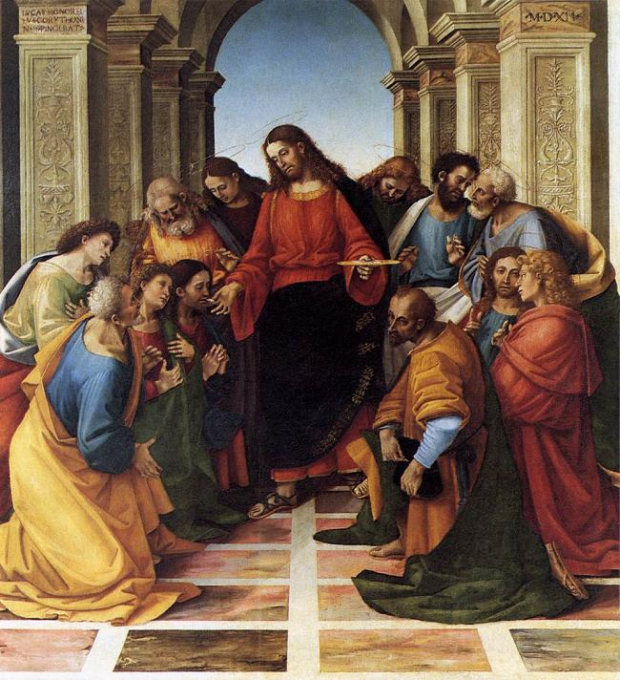
A Growing Movement
Define Apostles:
12 of Jesus' disciples (followers) some of which wrote the Gospels.

Slide 6
A Growing Movement
What the special appeal of Jesus?
He ignored wealth and status
Healer
Peaceful; people were touched by his message

Slide 7
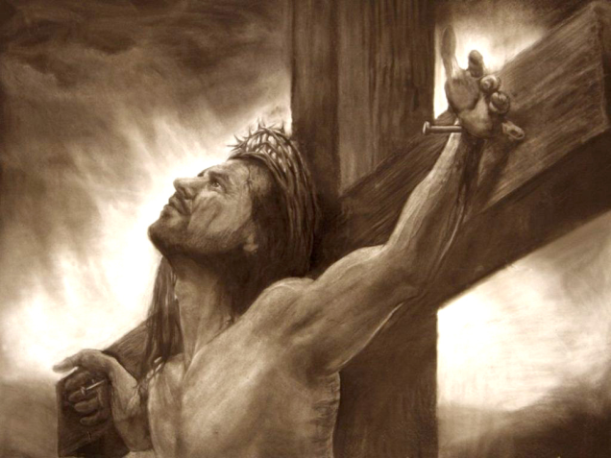
Jesus' Death
Why was Jesus crucified?
He was seen as a threat to the authority of Rome
Who ordered the crucifixion?
Pontius Pilate

Slide 8
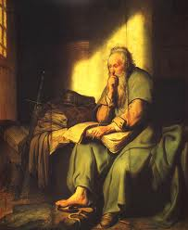
Christianity Spreads Through the Empire
Paul’s Mission
Who was Paul and what did he do?
Apostle who wrote letters which are a big part of the New Testament of the Bible
How did Pax Romana help the spread of Christianity into Rome?
Allowed safe travel and trade---> spread ideas

Slide 9
Persecution of Christians
Why did the Romans dislike Christians?
Christians refuse to worship Roman gods.

Slide 10
A World Religion
Why did Christianity Grow?
Embraced all people
Gave hope to the powerless
Appealed to those who were sick of Rome
Offered a personal relationship to God
Promised eternal life after death

Slide 11
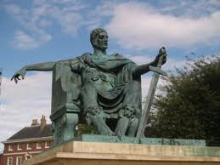
Constantine Accepts Christianity
How does Constantine's acceptance of Christianity increase its growth?
Issued the Edict of Milan: made Christianity legal

Slide 12
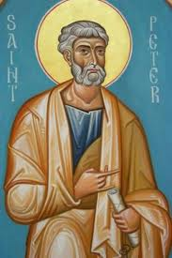
Early Christian Church
Describe how Peter is the first Bishop & Pope of the Christian church.
Jesus said Peter would be the “Rock upon which the Christian Church would be built”

Slide 13
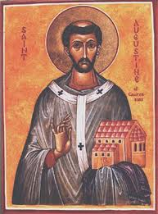
Fathers of the Church
What did St. Augustine teach about Christianity?
The City of God is more important than cities like Rome

