Slide 1
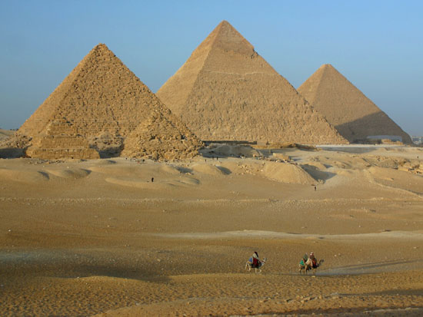
Outcome: Geography, Culture, & The Old Kingdom
Ancient Egypt & Judaism

Slide 2
Constructive Response Questions
Describe the geography of Egypt and its surrounding lands:
Describe Egyptian culture including details on their government, religion, and social structure.

Slide 3
What will we learn?
Geography of Egypt
The Old Kingdom
Egyptian Culture

Slide 4
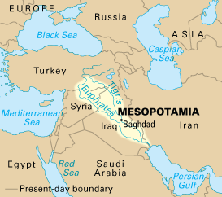
Geography, Culture, & The Old Kingdom
Setting the Stage
Mesopotamia was home to the first civilization
Egypt will be one of the first empires: unity, stability, and cultural continuity

Slide 5
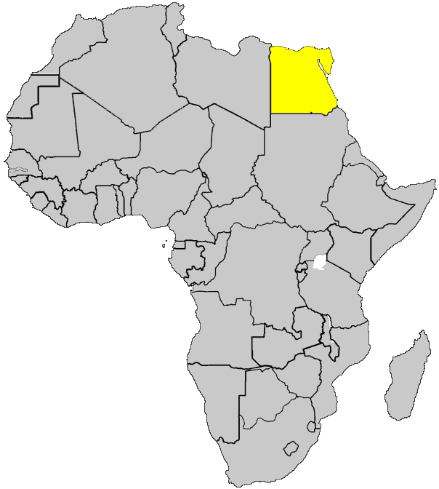
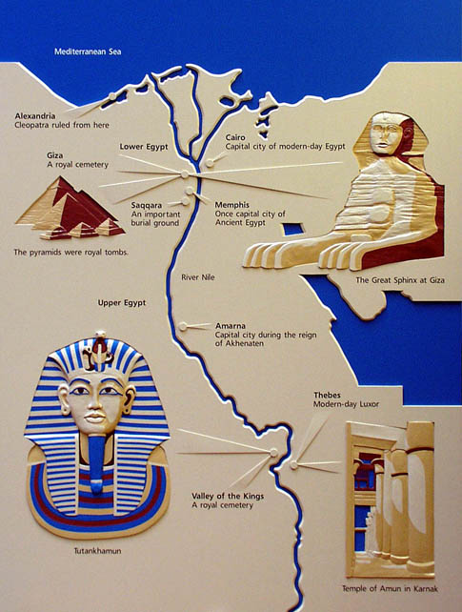
Egypt is in Africa

Slide 6
Geography, Culture, & The Old Kingdom
The Geography of Egypt: The Nile
The Nile River is the most important resource
Used for transportation, irrigation, defense, agriculture
The Nile is the longest river in the world at 4,100 miles long
Yearly flooding brought rich soil that would be left as the water receded
The Egyptians worshipped The Nile as a god
The Nile flooded like clockwork each year; unlike Mesopotamia
The Nile flows north, unlike most rivers
The Nile valley is surrounded by sun parched desert

Slide 7
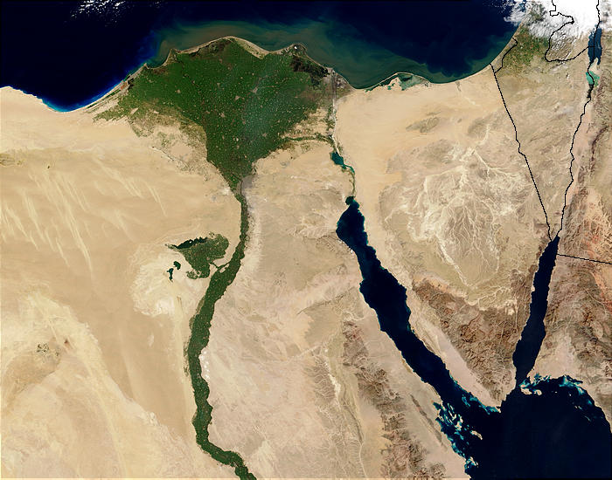
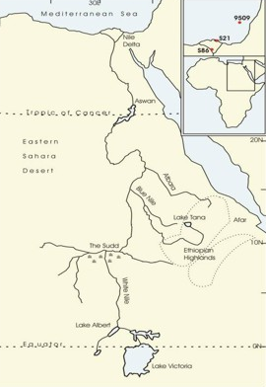
The Nile

Slide 8
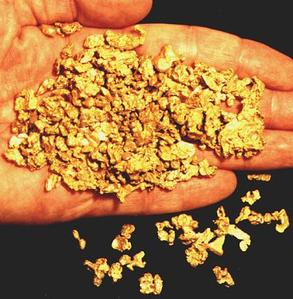
Geography, Culture, & The Old Kingdom
Three disadvantages:
If flooded a few feet less than normal, thousands would starve
If flooded a few feet more than normal, homes & property destroyed
Desert on each side of river forced Egyptians to live on small strip of land on the river- however, this also acted as a natural barrier against invaders
Upper and Lower Egypt (see map on p.36 or next slide)
Nubia to the south was rich in gold and was subject to Egypt’s authority

Slide 9
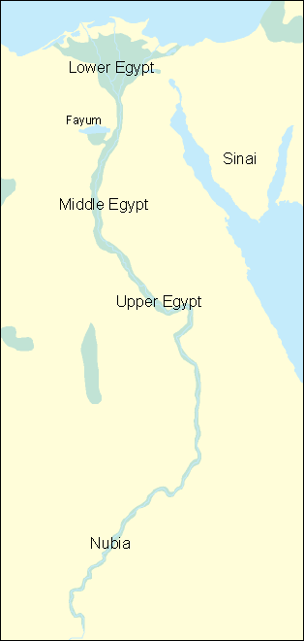

Slide 10
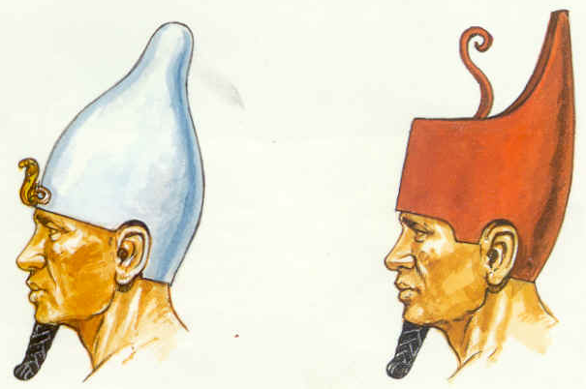
Geography, Culture, & The Old Kingdom
Egypt Unites into a Kingdom
A king named Narmer united Upper and Lower Egypt into one empire in 3000 BC
Narmer Palette depicts with hieroglyphics how Narmer unified Egypt
Narmer is sometimes called the Scorpion King
Narmer created the first Egyptian dynasty
Ancient Egypt would see 31 dynasties spanning 2,600 years

Slide 11
The Scorpion king…NO!

Slide 12
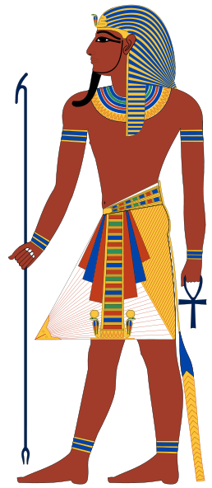
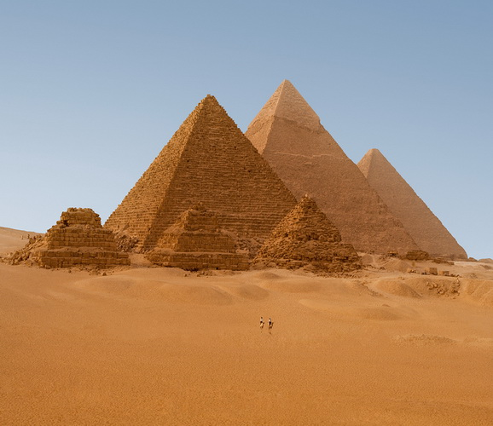
Geography, Culture, & The Old Kingdom
The Old Kingdom
Old Kingdom or “Age of Pyramids”
2660-2180 B.C. when many patterns for Egyptian Civilization were established
Most of the pyramids were built in this time period
Pyramid: immense stone structure often built as tombs

Slide 13
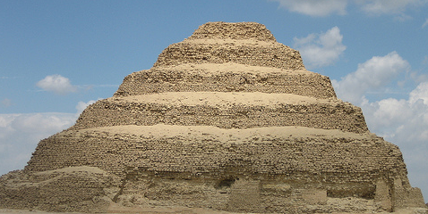
Geography, Culture, & The Old Kingdom
Djoser built the Step Pyramid

Slide 14
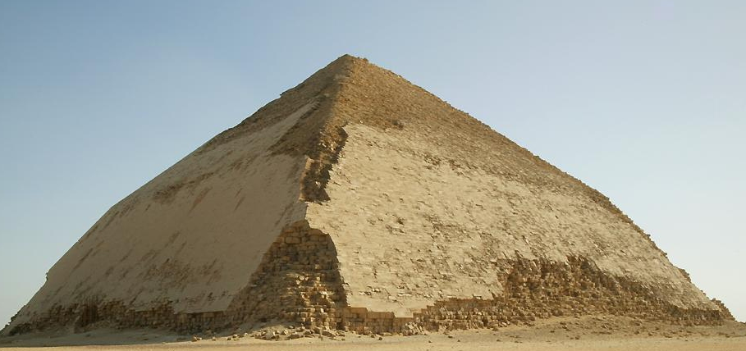
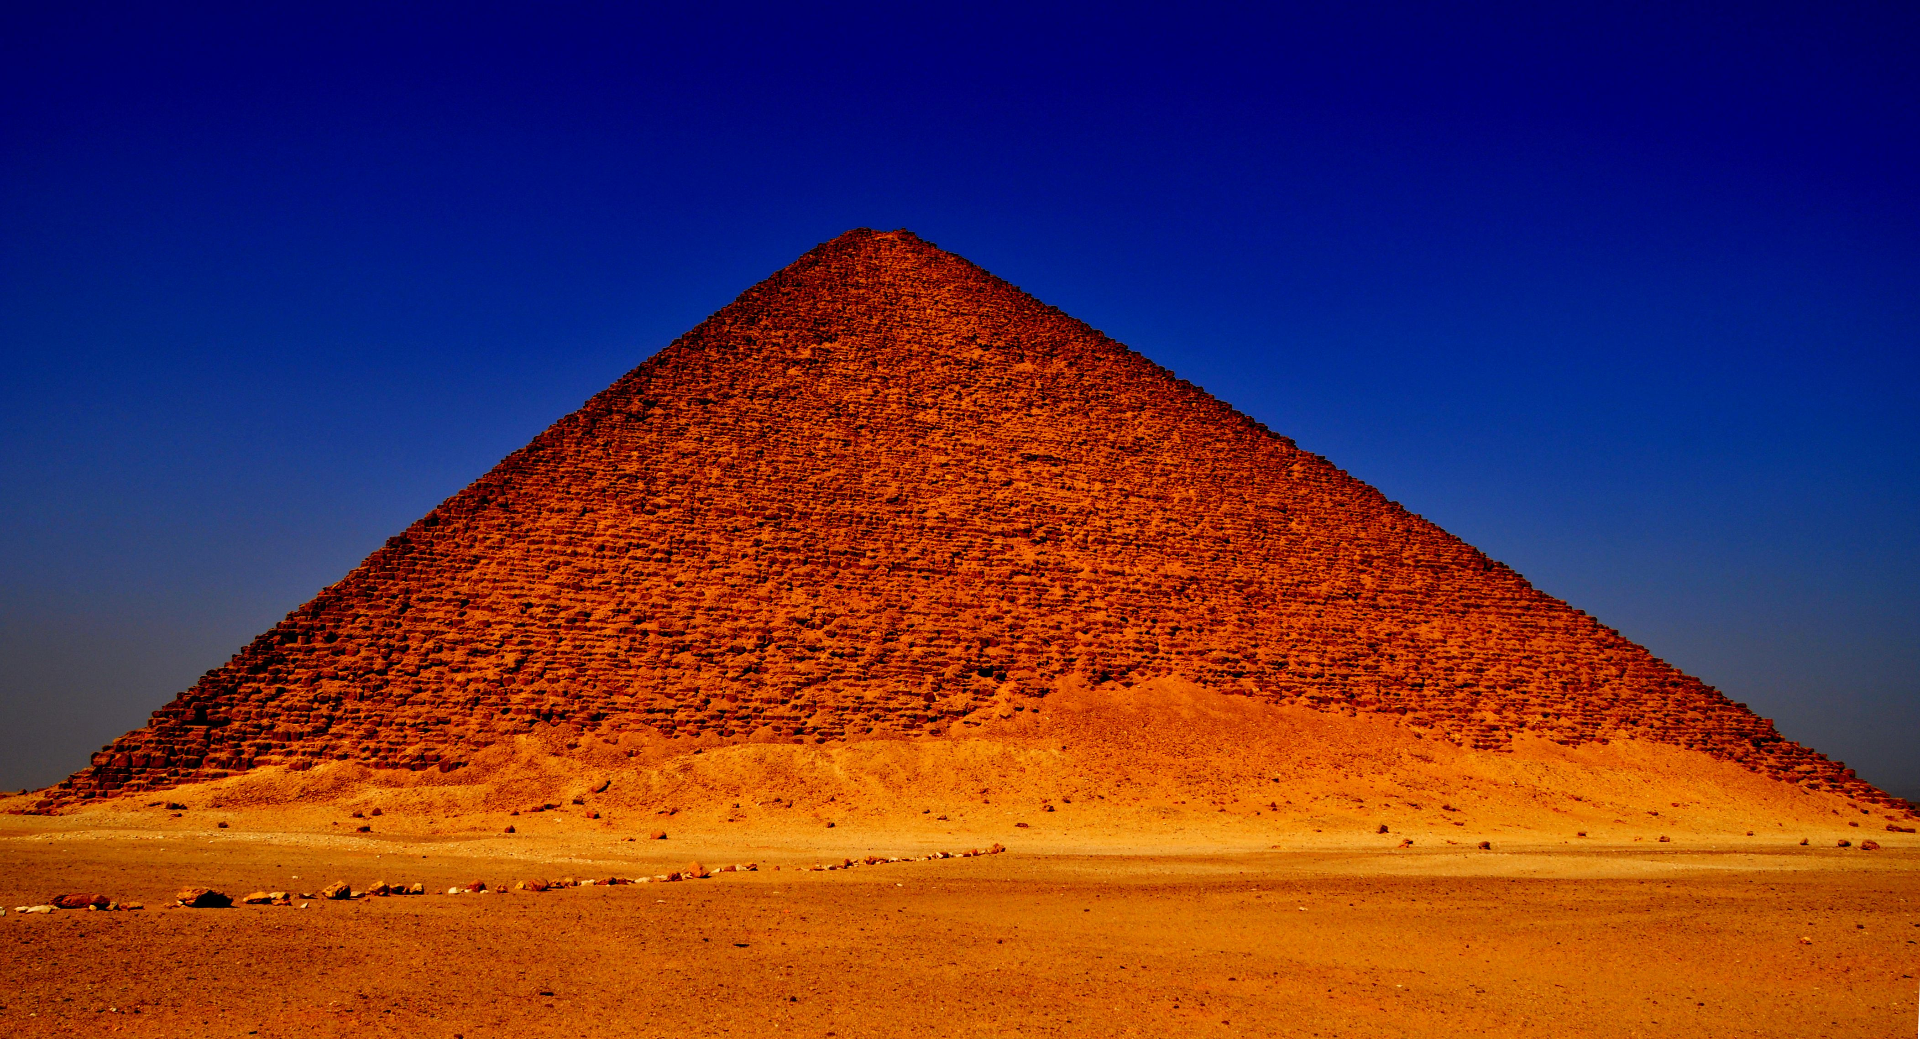
Geography, Culture, & The Old Kingdom
Snefru built the Bent Pyramid
Snefru built the Red Pyramid
Eventually the power of the pharaohs declined and ended Old Kingdom

Slide 15
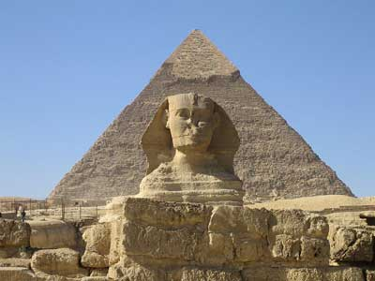
Geography Culture, & The Old Kingdom
Khufu built the first of the Great Pyramids at Giza

Slide 16
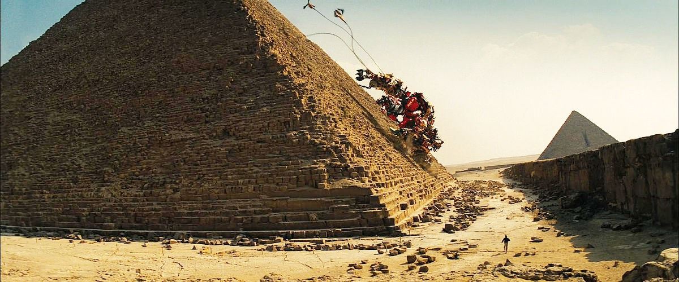
Never happened…

Slide 17
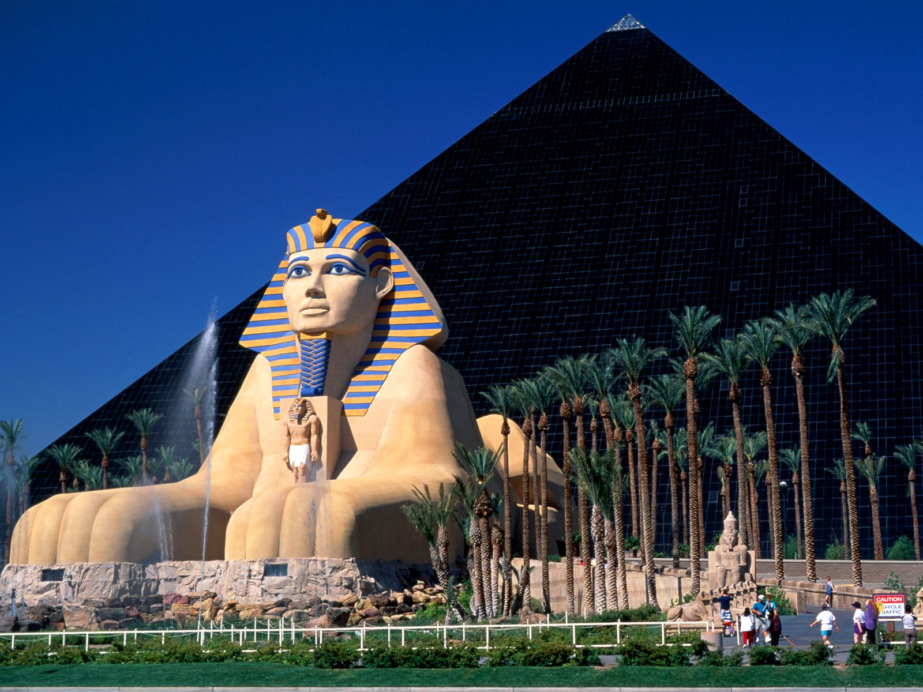
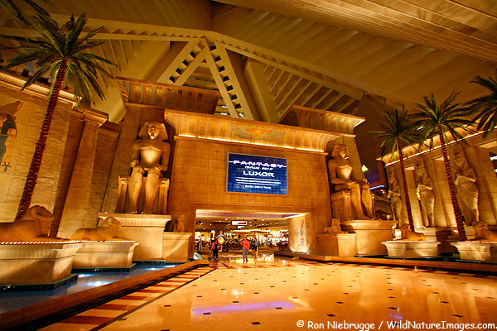
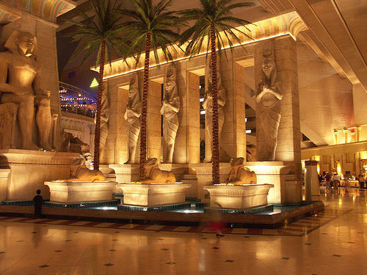
Tourism + Egypt = Money
Luxor Hotel in Las Vegas, NV

Slide 18
Geography, Culture, & The Old Kingdom
Egyptian Culture
Pharaohs: Egyptian pharaohs ruled absolutely
The pharaohs stood at the center of Egyptian culture, government, and religion
This type of government in which rule is based on religious authority is a theocracy
Polytheistic: belief in many gods
Re (sun god), Osiris (god of the dead), Goddess Isis (represented ideal mother and wife)
Believed in afterlife and built burial chambers and tombs
Mummification: embalming and drying of corpses to prevent decay

Slide 19
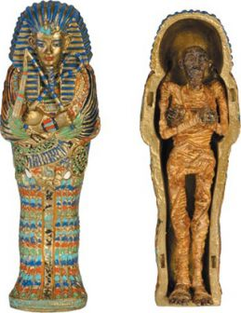
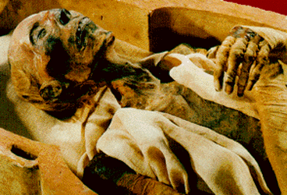
Mummies

Slide 20
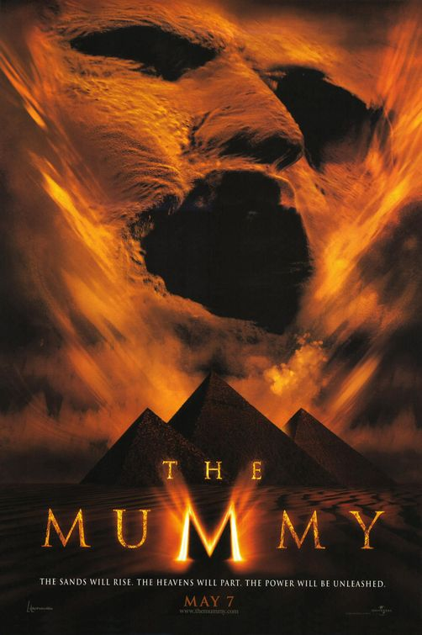
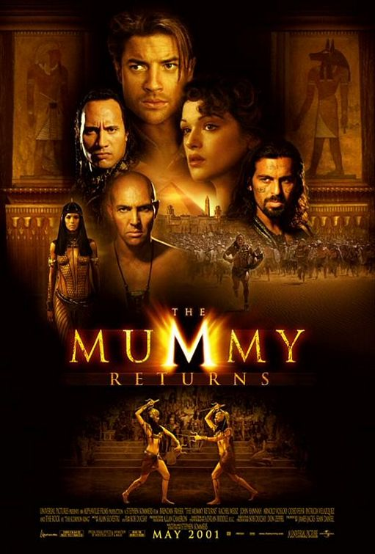
The Mummy

Slide 21
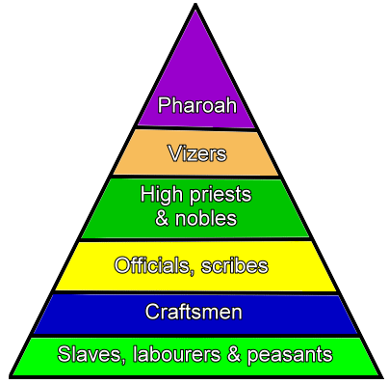
Geography, Culture, & The Old Kingdom
Egyptian Society
Pharaoh's most trusted advisor

Slide 22
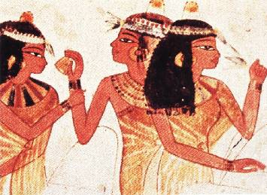
Geography, Culture, & The Old Kingdom
Not locked into social class
Women held many of the same rights as men
Could propose marriage
Often married between ages 14-16
If granted a divorce, she was entitled to one-third of the couple’s property

Slide 23
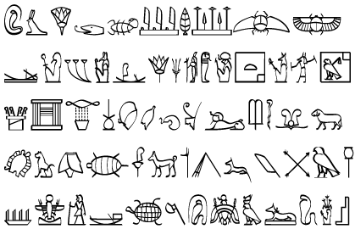
Geography, Culture, & The Old Kingdom
Egyptians wrote using hieroglyphics or carvings of symbols and pictographs
Symbols stood for ideas instead of words
Invented a writing surface out of papyrus reeds
Egyptians created a 365 day calendar with 12 months of 30 days
Egyptian doctors knew about human pulse, how to set broken bones, and even used surgery in some cases

Slide 24
Geography, Culture, & The Old Kingdom
Result: The Egyptians had accomplished something no one had ever done: Built one of the first truly unique united empires on the planet.

Slide 25
Constructive Response Questions
Describe the geography of Egypt and its surrounding lands:
Describe Egyptian culture including details on their government, religion, and social structure.

