Slide 1
Capitalism, Socialism, and Communism

Slide 2
Industrial revolution spreads….
Rising Economic Powers are all industrial
Each will want access and control over RAW MATERIALS and MARKETS
raw materials:
Markets:
Q: What might happen when industrial nations want what NON-industrial nations have? What effect will the “industrial vs. NON-industrial tension” have on the world?

Slide 3
CAPITALISM
Capitalism is an economic system based on PRIVATE OWNERSHIP and the use of CAPITAL
Growth of towns and cities and the expansion of trade in the late Middle Ages sparked this economic development
Three Main Features to learn BY HEART:

Slide 4
CAPITALISM
1. Private Ownership
2. Profit motive
3. Market Economy

Slide 5
CAPITALISM
1. Private Ownership: Capital belongs to individuals who are FREE to do what they wish with it. For this reason, capitalism is also called the “free-enterprise” system

Slide 6
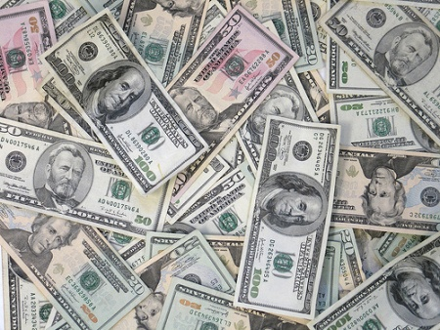
CAPITALISM
2. Profit Motive: based on the economic laws of supply and demand, when enough people want something, producers make it because they want a PROFIT

Slide 7
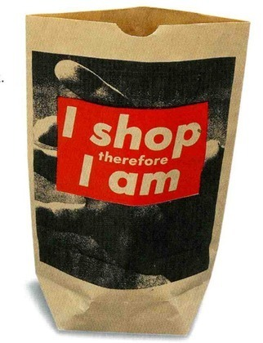
CAPITALISM
3. Market Economy: a money value can be placed on everything in the marketplace: land, goods, time, and labor. Buyers and sellers are free to exchange goods and services at prices determined by…..”SUPPLY and DEMAND”

Slide 8
Basic Laws of Supply and Demand
DEMAND = “More of a good will be demanded the lower its price. Less of a good will be demanded the higher its price”
Ex 1. Diamonds are expensive because they are rare. (Women do not want cut quartz in their rings!)
Ex. 2. When calculators first came out, they were over $600. Now you can get them in cereal boxes!

Slide 9
Basic Laws of Supply and Demand
SUPPLY: “More of a good will be supplied the higher its price. Less of a good will be supplied the lower its price”.
EX: If a person can get 300% profit on selling smartees, more people will start supplying smartees to get the profit. But it won’t last long…because more people selling the same product means more product to sell….demand drops and the price comes down….

Slide 10
Role of “PRICE” in relation to the laws of supply and demand:
“When the quantity DEMANDED is GREATER than the quantity SUPPLIED, prices tend to…. “GO UP/INCREASE” . (WHY?)
“When the quantity SUPPLIED is greater than the quantity DEMANDED, prices tend to….”GO DOWN/DECREASE”. (WHY?)

Slide 11
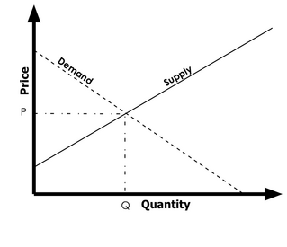
On a “price/quantity” chart……
Q: Why does a DEMAND curve always slope downward?

Slide 12
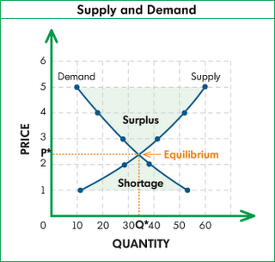
Q: Why does a DEMAND curve always slope downward?
Answer: The demand curve always slopes downward because as more of an item becomes available, the lower the price.

Slide 13
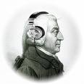
IR and Capitalism: Laissez-Faire figures
Adam Smith : CAPITALISM/Laissez-faire
Wealth of Nations, 1776
“the individual, pursuing his SELF-INTEREST, will bring on general benefits to society”
NEED for free markets (no government intervention)

Slide 14
IR and Capitalism: Laissez-Faire figures
Thomas Malthus: predicted that the population would outpace the world’s food supply
People should limit kids
Wrote: An Essay on the Principle of Population
No gov’t help for the poor

Slide 15
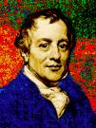
IR and Capitalism: Laissez-Faire figures
David Ricardo: “iron law of wages”
Limit kids b/c people have more kids when $ is strong;
increase in labor later means a decrease in $$ and….
Unemployment increases
“No gov’t help for the poor”
IRON LAW OF WAGES

Slide 16
Effects of Capitalism
“Profit” for owners of production/business
Industrial vs agricultural economies
Market competition = price of “things” goes down……(because)
Increased supply of “things”/goods
Focus on PERSONAL RESPONSIBILITY

Slide 17
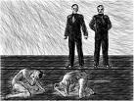
Criticisms of Capitalism
Uneven distribution of WEALTH
Poor people live in SQUALOR: slums, bad sanitation, etc.
Working conditions are miserable, etc, etc. see negative effects of Industrialization

Slide 18
Responses to “Capitalism”
“ISMs…..all over the place”, focus on keeping them straight!
Utilitarianism
Utopianism
Socialism
Communism

Slide 19
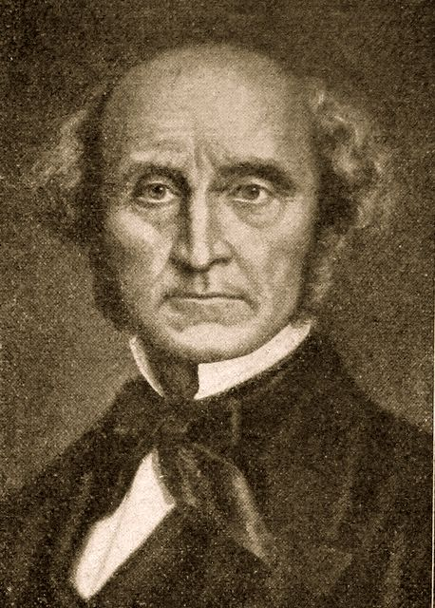
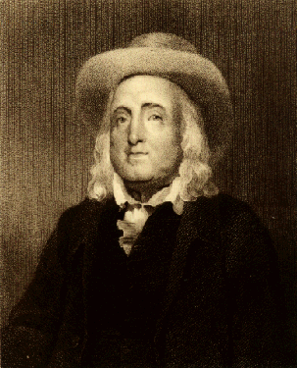
Utilitarianism: “greatest good for the greatest number”
“advance the greatest good for the greatest number”
“Government should enact reforms that promote more happiness”
John Stuart Mill
Jeremy Bentham

Slide 20
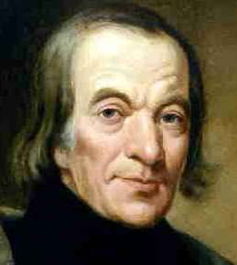
Utopianism: ideal society based on cooperation instead of competition
Utopia By Thomas More described an ideal society
“utopia” in Greek means NO PLACE!!
Robert Owen: campaigned for child labor laws
Encouraged unions
Set up model, self-sufficient community to show that it was possible to be nice to workers and still make a profit
New Lanark, Scotland worked
New Harmony in AMERICA failed

Slide 21
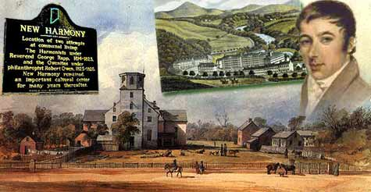

Slide 22
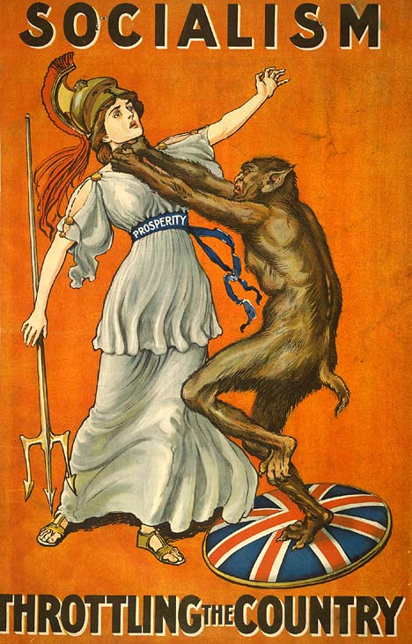
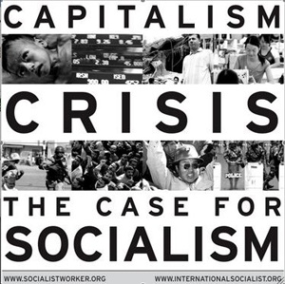
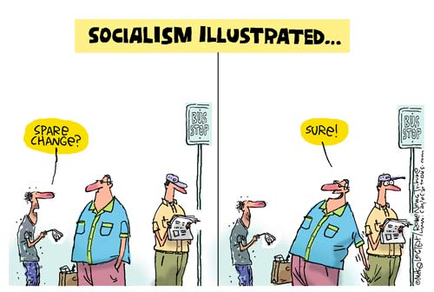
Socialism: society (In the form of the government) owns the means of production and key infrastructure
Principles:
“Equality of all People”
Cooperation is better than competition
…at least in industry

Slide 23
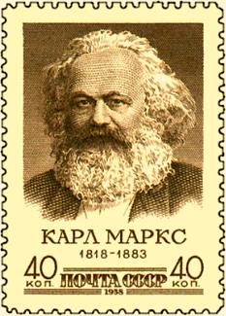
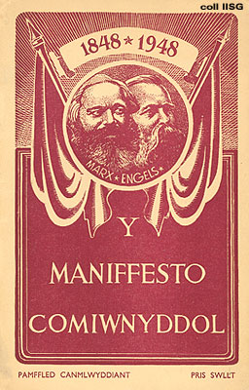
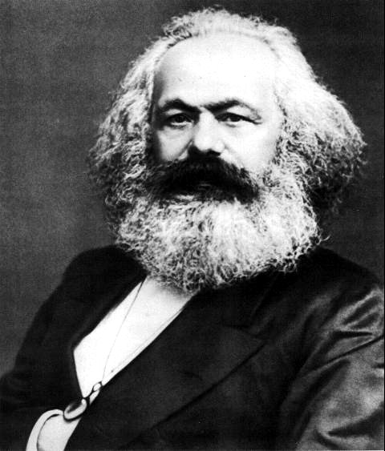
COMMUNISM: extreme form of socialism in which “all people” own the means of production as the state “withers away” and produces a classless society

Slide 24
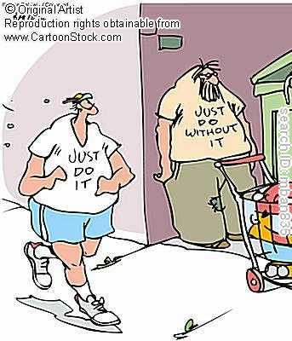
Karl Marx’s theory of Communism
Idea: that History is shaped by ECONOMIC FORCES (the way goods are produced and distributed)
CLASS STRUGGLE has always existed between the “haves” and the “have nots”
In industrial times the “haves” are the bourgeoisie/middle class capitalists; the “have nots” are the wage earning laborers

Slide 25
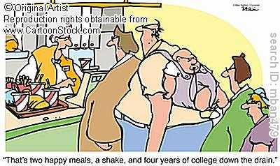
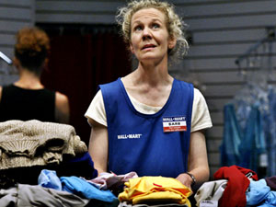
Marx’s communist ideas…continued
The social class that holds the economic power also controls the government for its own advantage… (class wealth = class power)
Middle class shrinks (small businesses are ruined by capitalist giants)
Working class GROWS as masses of poor labor at the mercy of a small, rich elite class

Slide 26
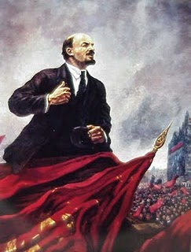
How communism is supposed to happen:
Poverty and desperation drive MASSES of workers (proletariat) to:
seize control of the government and the means of production
destroy the capitalist system
wage a VIOLENT REVOLUTION
establish a “dictatorship of the proletariat”

Slide 27
After the “dictatorship of the proletariat” occurs…..
All property and the means of production are owned by “the people”
All goods and services are “shared equally”
A “classless society” emerges
the “state withers away”

Slide 28
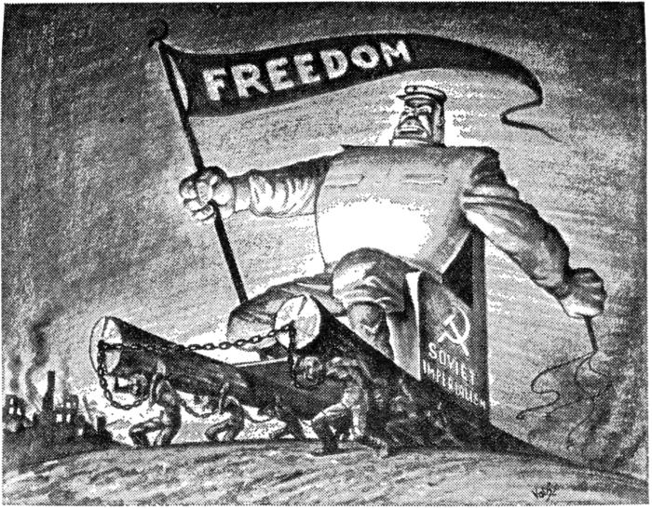
“Communist Paradise?”

Slide 29
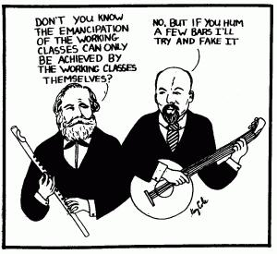
Effects of Marxist thought
Formation of socialist political parties
Advocate and support revolutions
Push for work reforms
Fight against “capitalism”
Communists take over Russia
Communism used by revolutionaries
Dictatorships of Communist Party leaders
No communist paradise established anywhere

Slide 30
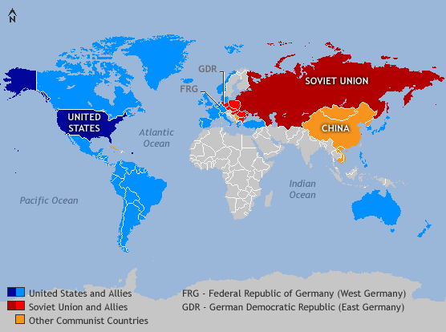
Effects of Marxist thought
“Red Scare” = hysteria over perceived threat of communism/ civil liberties revoked
US foreign policy based on fighting spread of communism after World War II
“COLD WAR” with USSR and allies
Proxy wars fought on both sides

Slide 31
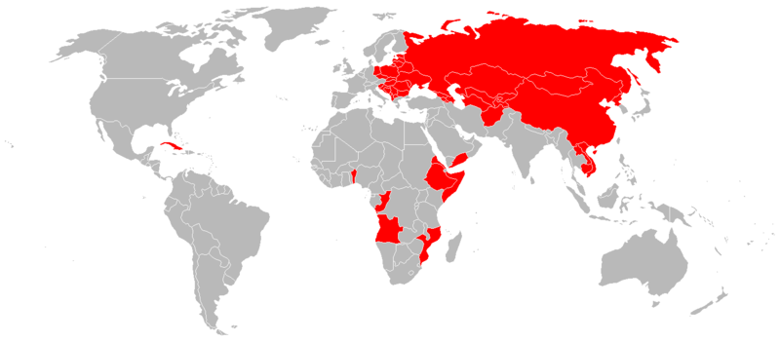
The “perceived threat of communism”…a visual

Slide 32
As of 2010, there are five one-party communist nations: People's Republic of China Republic of Cuba Democratic People's Republic of Korea (North Korea) Lao People's Democratic Republic (Laos) Socialist Republic of Vietnam

