Slide 1
The Persian Wars
The Battle of Salamis

Slide 2
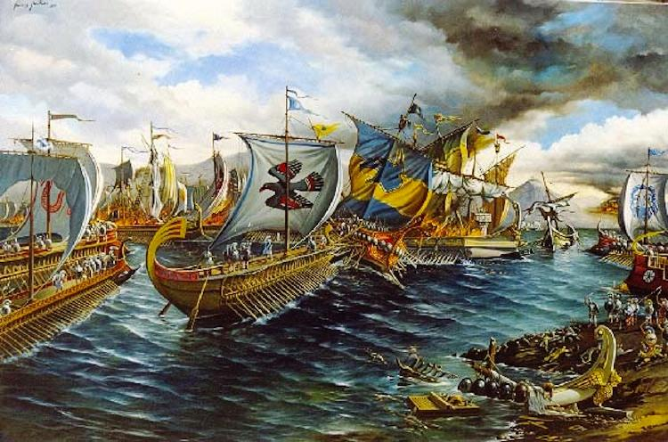
The Battle of Salamis

Slide 3
Constructive Response Question
Who were the Persians and how did they disrupt life for the Greeks?

Slide 4
Depicted in…

Slide 5
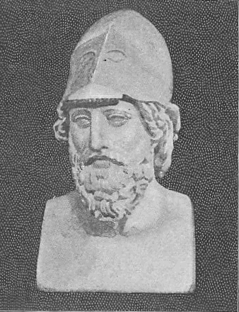
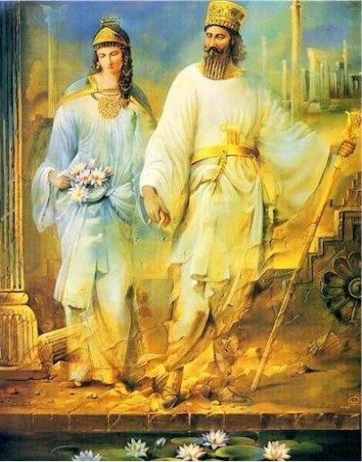
The Battle of Salamis: Who?
Athenian Admiral Themistocles
Persian King Xerxes

Slide 6
The Battle of Salamis
Who:
Athenian Admiral Themistocles & the Athenian Navy
Vs.
Xerxes and the Persian Navy

Slide 7
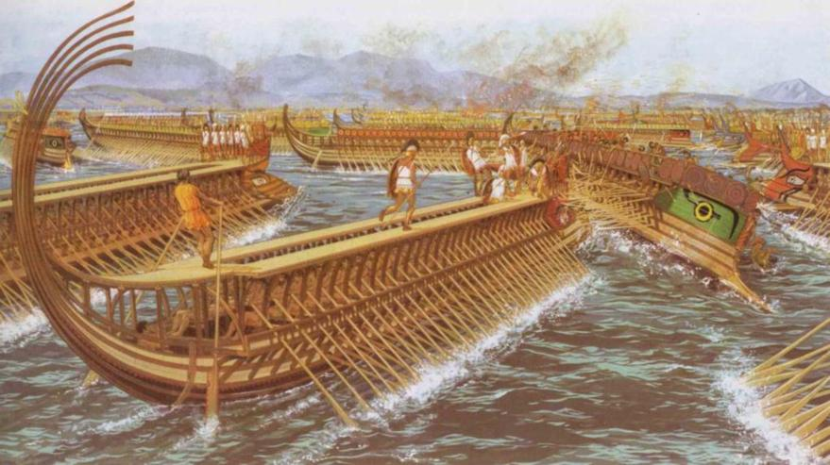
Greek Triremes

Slide 8
The Battle of Salamis
Why:
Xerxes burned Athens down after his victory at Thermopylae
He chased the Athenians
Greeks were protecting Greece!

Slide 9
The Battle of Salamis
When:
480 B.C.
Where:
The narrow straights of Salamis west of Athens (Saronic Gulf)

Slide 10
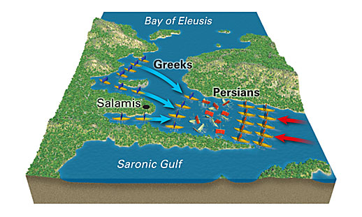

Slide 11
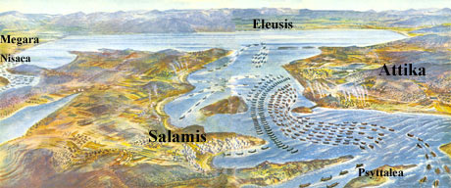

Slide 12
The Battle of Salamis
What happened:
Themistocles evacuated Athens and knew the Athenians were better at naval warfare
Positioned his fleet near the island of Salamis west of Athens
Themistocles lured the Persians in
The Persians had trouble turning in the narrow channel
Greek triremes destroyed over 1/3rd of Xerxes ships
Now the Persians were on the defensive, not offensive

Slide 13
Constructive Response Question
Who were the Persians and how did they disrupt life for the Greeks?

