Slide 1
The Persian Wars

Slide 2
The Battle of Marathon

Slide 3
Constructive Response Questions
#4: Who were the Persians and how did they disrupt life for the people of Greece?
#5 In a short paragraph, describe what happened and the significance of the battle of Marathon or Thermopylae.

Slide 4
Our Plan
5 W’s
Who (Who was fighting who?)
Where?
Why?
When?
What happened?

Slide 5
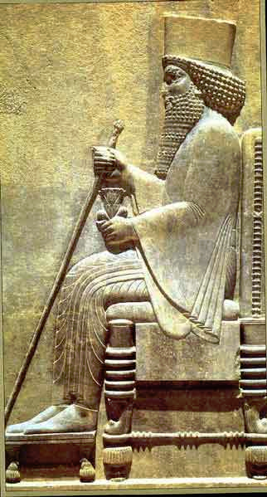
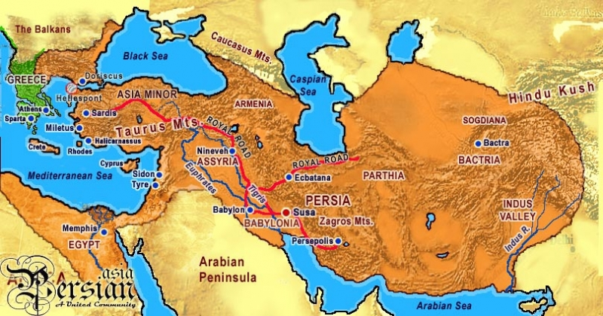
The Battle of Marathon
Who?
The Persian Army vs. Athenian Army
King Darius I of Persia

Slide 6
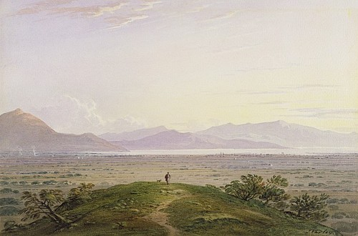
The Battle of Marathon
Where?
Marshy plains of Marathon outside of Athens

Slide 7
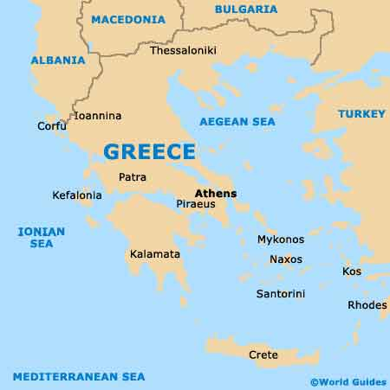
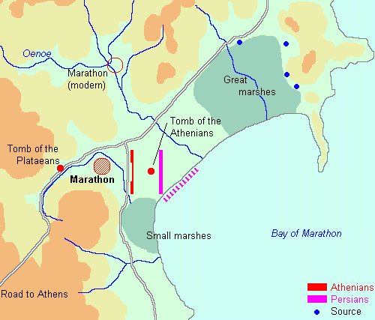

Slide 8
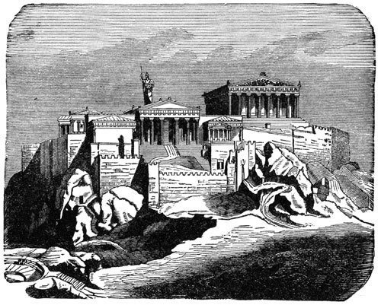
The Battle of Marathon
Why?
The Persians wanted to invade & conquer Greece.
When?
490 B.C.

Slide 9
The Battle of Marathon
What happened?

Slide 10
Pheidippedes

Slide 11
The Battle of Marathon
Who won?
Athens! (The Greeks)

Slide 12
Constructive Response Questions
#4: Who were the Persians and how did they disrupt life for the people of Greece?
#5 In a short paragraph, describe what happened and the significance of the battle of Marathon or Thermopylae.

