Slide 1
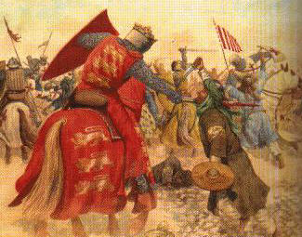
The Middle ages
Outcome: The Crusades

Slide 2
Constructive Response Questions
What were The Crusades and what effect did they have on the people of Europe and the Holy Lands?

Slide 3
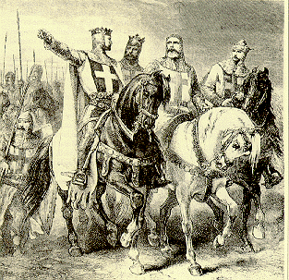
The Crusades
The Crusades
What is a crusade?
A _________ involving the journey of thousands of ____________ to reclaim the holy land of ______________ in the name of Christianity
In all, there were __or __Crusades (depending on your source)

Slide 4
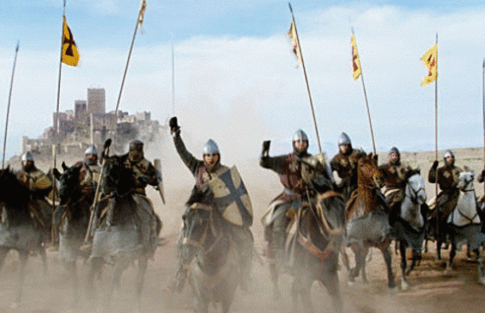
The Crusades
When were the Crusades?
Starts in _______ and lasts for nearly ______ years

Slide 6
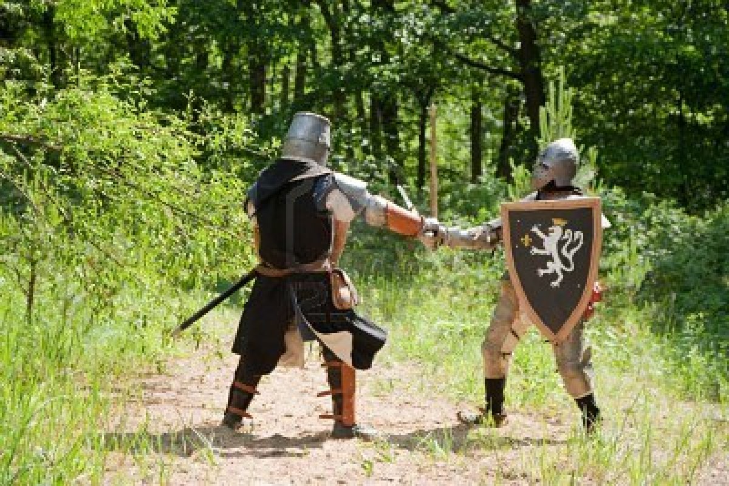
The Crusades
Why crusade? Social, Economic, Spiritual, & Political reasons
________: Opportunity to get __________ to stop fighting each other and fight a new foe. These knights _____________________ in Europe.
______________: The Holy Lands of Jerusalem were generally _________than Europe and many wanted to _______________of that wealth

Slide 7
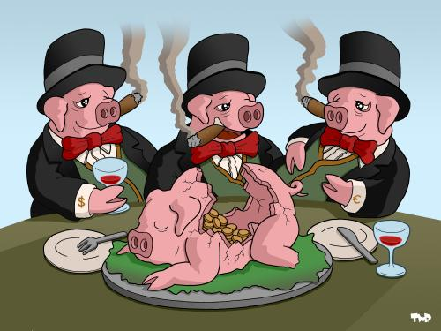
The Crusades
Why crusade? Social, Economic, Spiritual, & Political reasons
______________: Younger _________ who did not stand to inherit __________________________ were looking for __________ and adventure
_______________: Merchants supplied ________to finance the journey

Slide 8
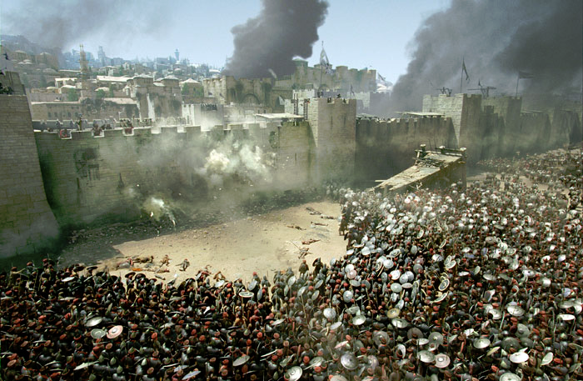
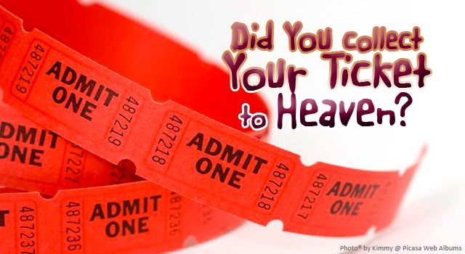
The Crusades
Why crusade? Social, Economic, Spiritual, & Political reasons
____________: A chance for the pope to _________________ instead of Byzantine rival
_________________: Fight/die on Crusade = ____________ to ____________(Christian contradiction)

Slide 9
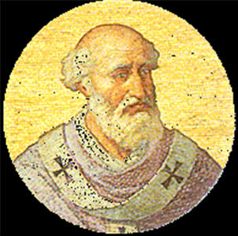
Pope Urban II

Slide 10
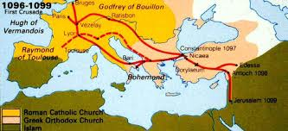
The Crusades
What happened:
First Crusade
_______________ called for a holy war against Muslims controlling holy lands
Urban’s call brought ___________________________ for the Crusade
Those who died on Crusade were assured a ______________________
“____________________!” was the battle cry
______ mile journey from Europe to Jerusalem
Eventually, _______ approached Jerusalem and besieged it for a month
On July 15, 1099, the ____________________________
In the process, the Christians _____________ all of the ______________left in the city

Slide 11
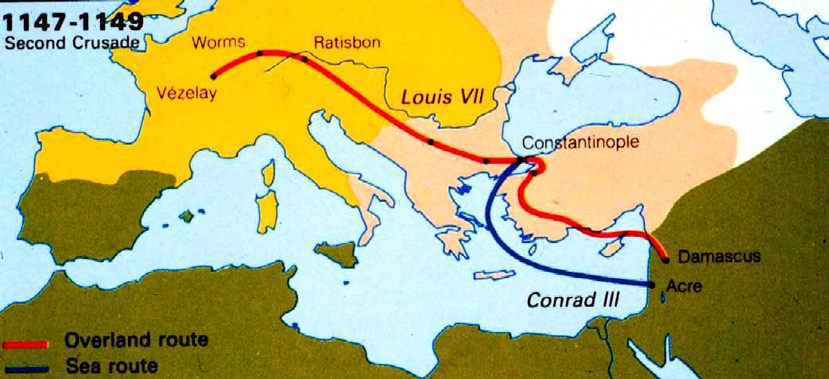
The Crusades
Second Crusade
The Muslim Army under command of _________ captured Jerusalem again in 1187
The _________________________ to defeat Saladin and recapture the city

Slide 12
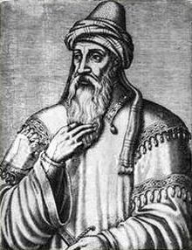
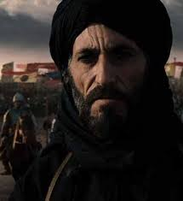
Saladin

Slide 13
The Second Crusade

Slide 14
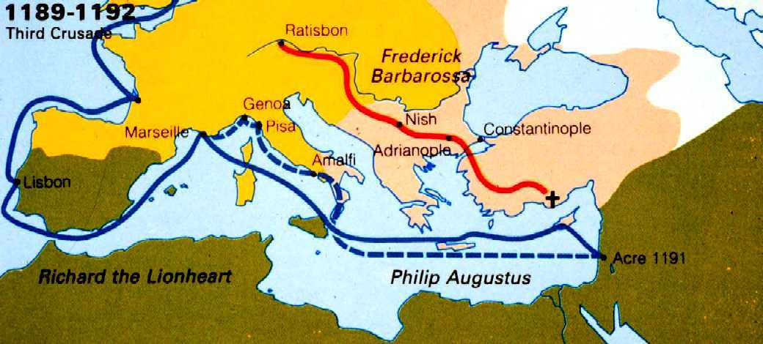
The Crusades
The Third Crusade
Led by 3 of Europe’s most powerful ________________
_____________ of France – went ____________
German Emperor ____________ – _____________ on journey

Slide 15
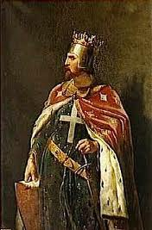
The Crusades
The Third Crusade
English __________________________
Fought many battles against ___________
Agreed to a ________with Saladin in 1192
Jerusalem stayed under __________________
Saladin promised _____________ could freely visit the city’s __________________

Slide 16
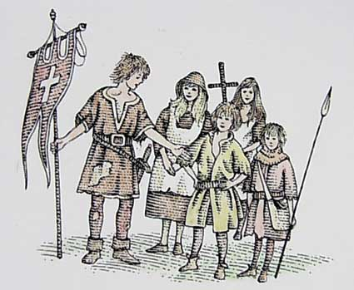
The Crusades
Other attempts
4th Crusade ___________ to recapture Jerusalem
In the 1200s, four more Crusades were also _____________
The _______________ Crusade

Slide 17
The Crusades
Effects of the Crusades
Example of Church ____________
___________________ between Europe and Southwest Asia
Thousands of __________ and other participants _____________
Those who survived brought back ____________ to Europe
Persecution of ______thousands were slaughtered because they were ________
Failure of later crusades ______________________________
The Crusades weakened the power of the __________________ (Knights were dead)
Began a legacy of ________ and _________ of Christians for the Muslims and ______________

Slide 18
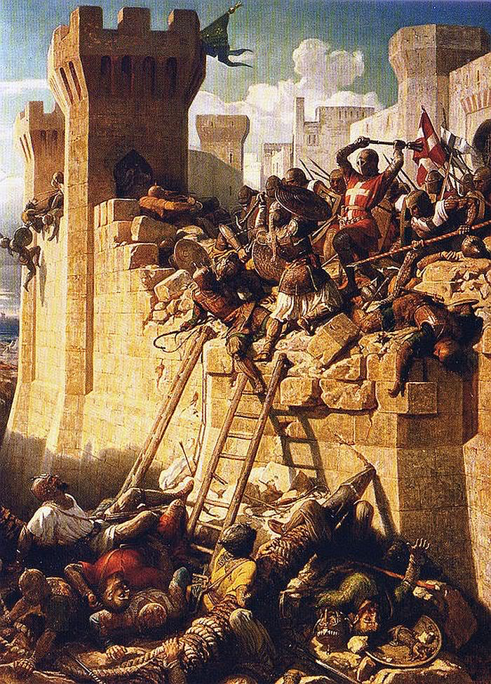
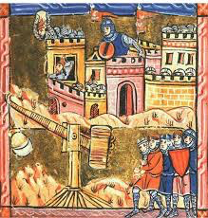
The Crusades
Result: The Crusades were a violation of “__________________.” It was also an example of an abuse of church ____________. The effects of the Crusades are ______________ through that region of the world today.

Slide 19
Constructive Response Questions
What were The Crusades and what effect did they have on the people of Europe and the Holy Lands?

