Slide 1
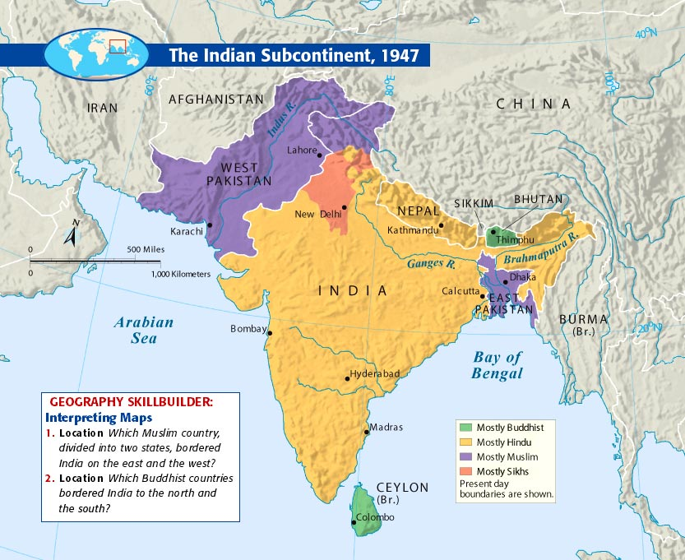
34.1 Indian Subcontinent Achieves Freedom
New nations emerge from the British colony of India.

Slide 2
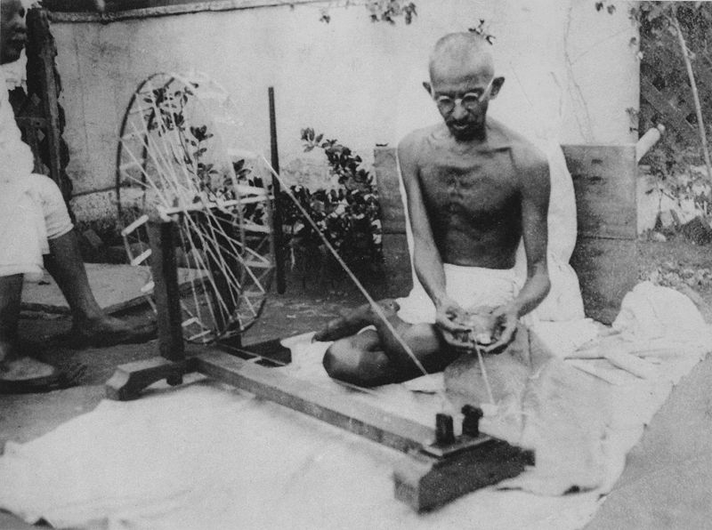
A Movement Toward Independence
Gandhi encouraged Indians to spin thread and weave their own cloth and wear traditional Indian clothing as a way get away from a dependence on British-made goods. Here Gandhi spins thread for his own clothing.

Slide 3
Struggling Against British Rule
Indian independence movement intensifies after World War II
Country is split; much animosity between Hindus and Muslims

Slide 4
Struggling Against British Rule
Congress Party is leading independence party; most members are Hindu.

Slide 5
Struggling Against British Rule
Muslim League—group formed to protect Muslim interests
The symbol to the right later becomes the flag of Pakistan.

Slide 6
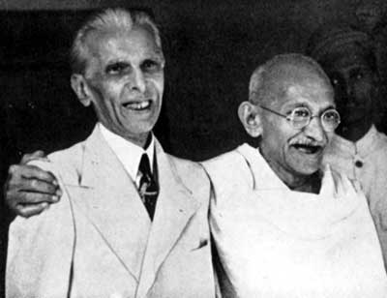
Struggling Against British Rule
Muhammad Ali Jinnah—Muslim League leader
Gandhi’s willingness to work with Muslims angered extremist Hindus.

Slide 7
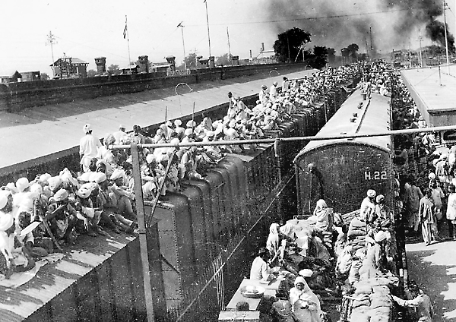
Freedom Brings Turmoil
A railway station in Punjab during large-scale migration that followed partition of India along religious lines.

Slide 8
Partition and Bloodshed
British adopt a policy of partition—splitting Indian into two countries
India would be largely Hindu nation; Pakistan mostly Muslim
Great Britain grants independence to both in 1947

Slide 10
Partition and Bloodshed
Millions leave their homes to resettle in Hindu and Muslim lands
Hindu-Muslim violence erupts during this movement; one million die

Slide 11
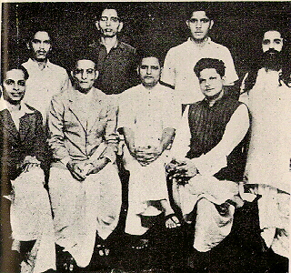
Partition and Bloodshed
Indian independence movement leader Mohandas Gandhi is assassinated by a radical Hindu Nathuram Godse, January 30, 1948.
Assassin opposed Gandhi’s support of Muslim rights
Supporters of Gandhi opposed his death sentence because they say it was against was Gandhi’s principles.
He was hanged November 15, 1949.
Group photo of the alleged conspirators.

Slide 12
The Battle for Kashmir
India and Pakistan fight over Kashmir, a region in northern India
Cease-fire in 1949, but disputes over the region continues.
In total, India and Pakistan have fought four wars
Indo-Pakistan War of 1947
Indo-Pakistan War of 1965
Indo-Pakistan War of 1971
Indo-Pakistan War of 1999 (minor war)

Slide 13
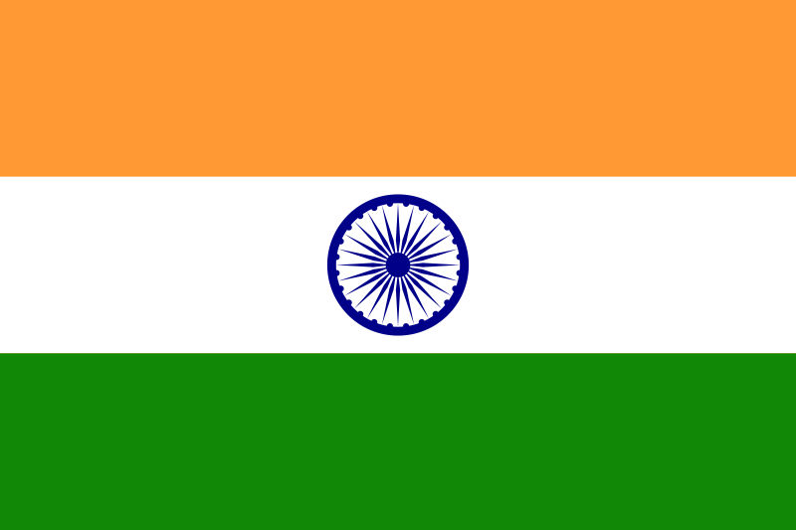
Modern India

Slide 14
Nehru Leads India
Jawaharlal Nehru becomes the first prime minister of independent India
Rules for 17 years; pushes for economic and social reforms
Leads alliance of countries that were neutral in Cold War

Slide 15
Troubled Times
Nehru’s daughter, Indira Gandhi, rules much of the time from 1966-1984.
She faces opposition from Sikhs, and is assassinated by Sikh bodyguards.

Slide 16
Troubled Times
Her son Rajiv Gandhi becomes prime minister, but is assassinated in 1991.

Slide 17
Twenty-First Century Challenges
India is one of the world’s most populous nations
India faces various population, social, and religious problems
India continues struggles with Pakistan; both become nuclear powers
Right—see the Prithvi I tactical missile capable of carrying a nuclear weapon.

Slide 18
Nuclear Power: India-Pakistan
Indian Nuclear Power Plants
Pakistani Nuclear Power Plants

Slide 19
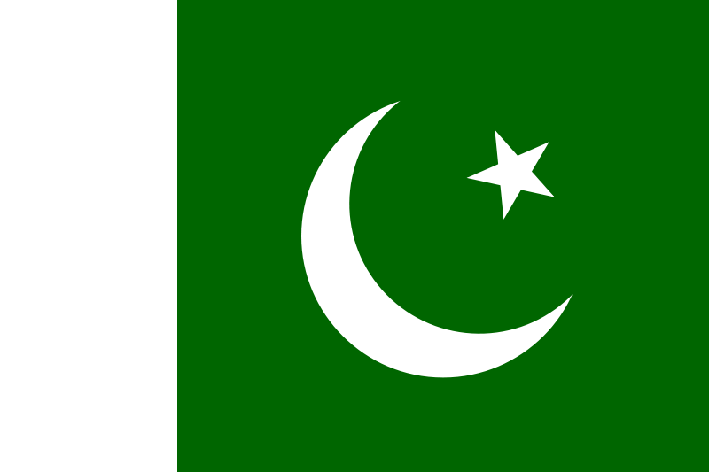
Pakistan Copes with Freedom

Slide 20
Civil War
Pakistan begins as two separate and divided states
East Pakistan is more populous; West Pakistan houses government
East Pakistan declares independence from West Pakistan in 1971
Civil war erupts; East wins, becomes new nation of Bangladesh

Slide 21
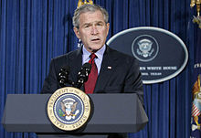
A Pattern of Instability
Many different governments rule Pakistan, non achieve stability
Benazir Bhutto leads Pakistan in 1980s and 1990s but is ousted. The military now rules.
Bhutto is assassinated in 2007.
U.S. President George W. Bush condemned the assassination in a 27 December press conference.

Slide 22
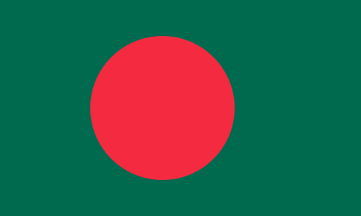
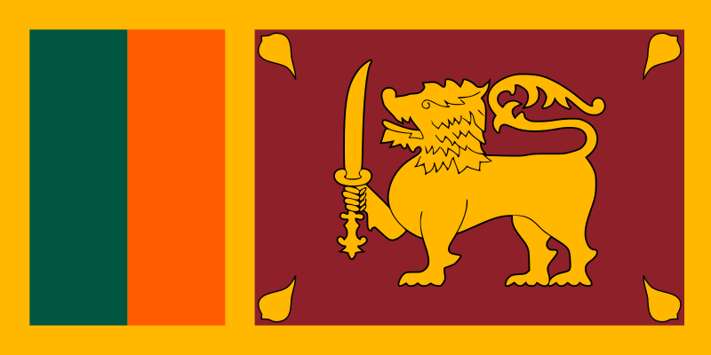
Bangladesh and Sri Lanka Struggle

Slide 23
Bangladesh Faces Many Problems
Bangladesh struggles with political instability; economic hardship
Also endures many natural disasters: storms and cyclones
1970 (Nov 12) Bhola Cyclone resulted in the deaths of up to 500,00 due mostly to flooding. This was the deadliest tropical cyclone ever recorded.

Slide 24
Civil Strife Grips Sri Lanka
Island of Sri Lanka, formerly Ceylon, wins independence in 1948
Population split between Buddhist Sinhalese and Hindu Tamils
Tamils begin fighting for their own state. They were defeated by the Sri Lankan Army in 2009.
Symbol of the Liberation Tigers of Tamil Eelam who saught independence from Sri Lanka. They were defeated in 2009.

